Slide 1
Beta Alpha Psi Induction
Greek Name chapter, School Name

Slide 2

"I do solemnly promise
that I will abide by the International Constitution
and Chapter Bylaws of Beta Alpha Psi
to the best of my ability.
I further promise to maintain
the highest moral and scholastic standing
and always to foster the ideals
and purposes of Beta Alpha Psi."

Slide 3
Candidates being inducted today
Name
Name

Slide 4




Slide 5

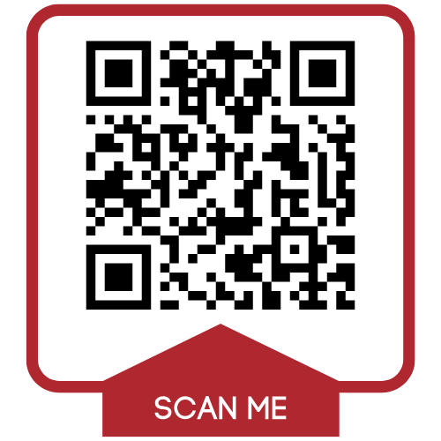
Claim Your Digital Membership Badge
Inducted members
Proudly display your membership badge on social media or in your email signature to highlight your involvement with Beta Alpha Psi to future employers and colleagues.

Slide 6


Join the Alumni & Member Network
Have you been inducted?
Join a global community of over 5,000 members, offering free access to exclusive networking, mentorship, and professional growth opportunities—log in or join today!

